Slide 1
Some basics

Slide 2
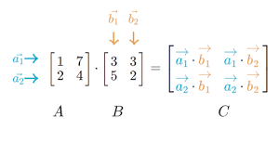
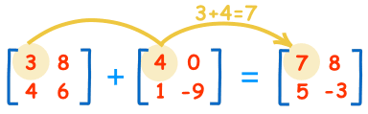

Slide 3
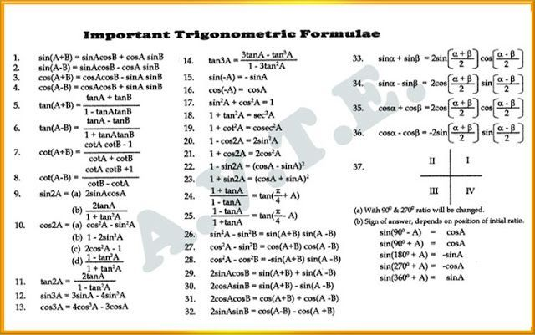

Slide 4
Program to draw a circle
#include<graphics.h>
#include<conio.h>
main()
{
int gd = DETECT, gm;
initgraph(&gd, &gm, "C:\\TC\\BGI");
circle(100, 100, 50);
getch();
closegraph();
return 0;
}

Slide 5
Module 2
Transformation

Slide 6
Contents
Object representations & Transformations- 2D & 3D
Affine transformations- Translation, scaling, rotation, reflection, shearing;
multiple transformations
Plane Geometric Projections- Parallel and Perspective Viewing

Slide 8
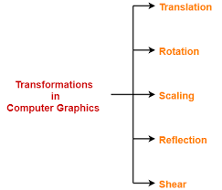

Slide 9
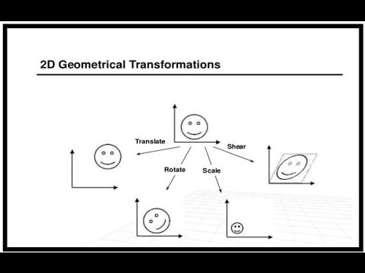

Slide 10
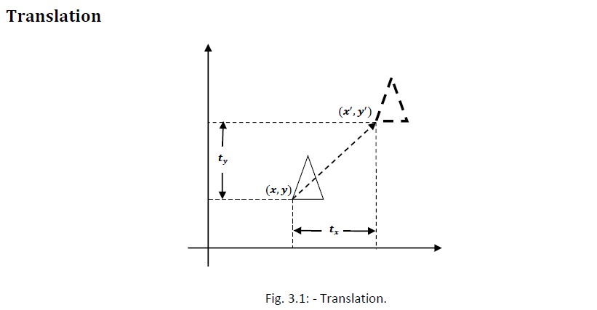

Slide 11
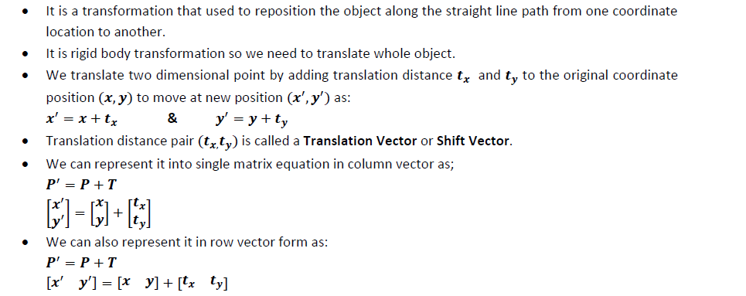

Slide 12
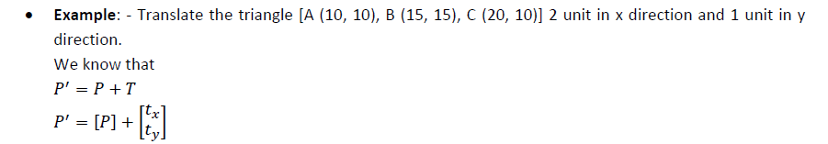
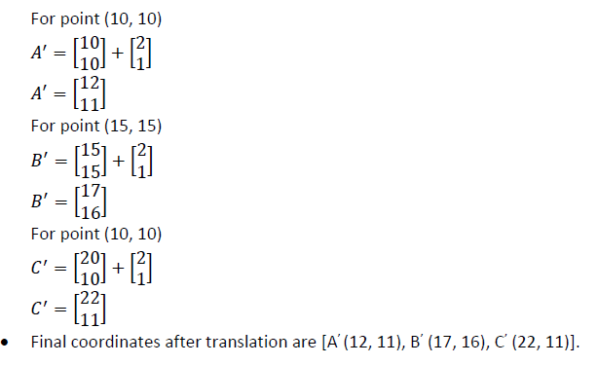

Slide 13
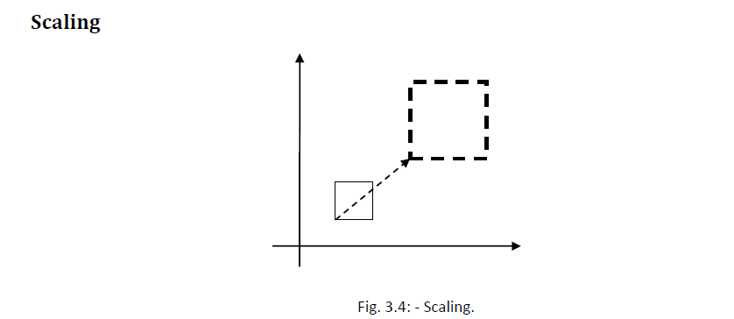

Slide 14
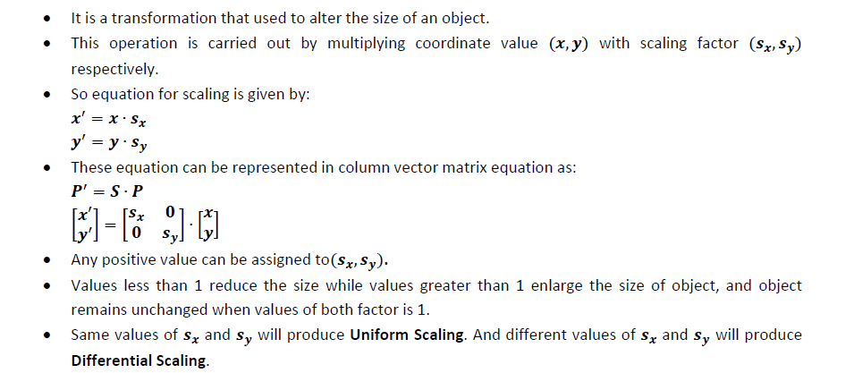

Slide 15
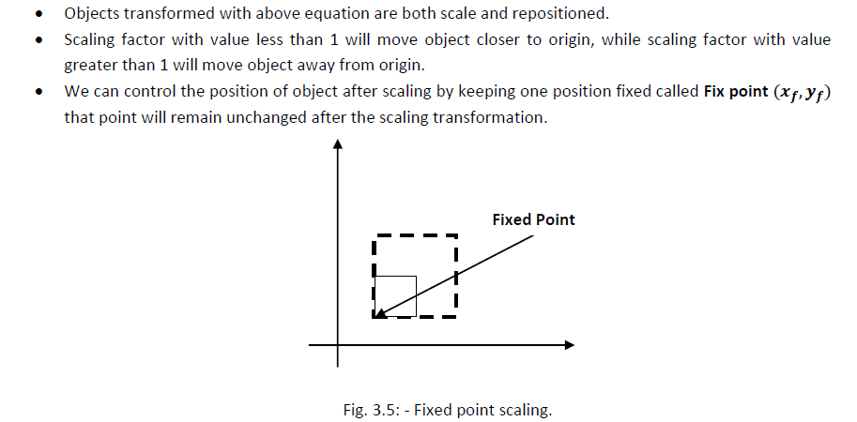

Slide 16
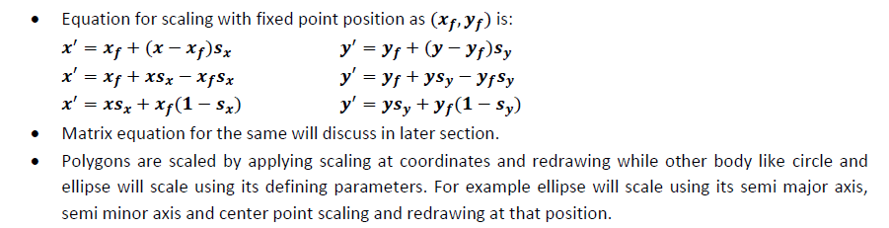

Slide 17
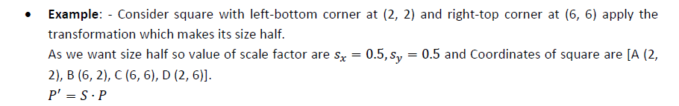
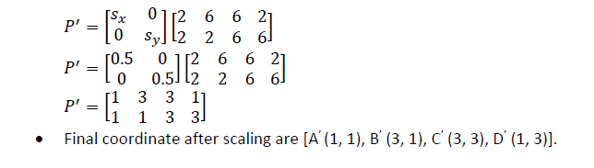

Slide 18
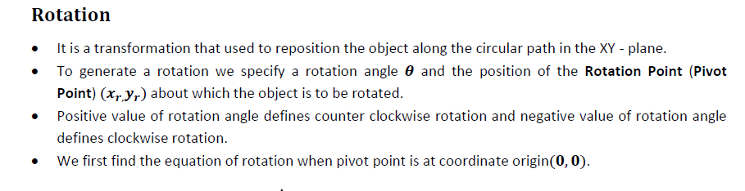
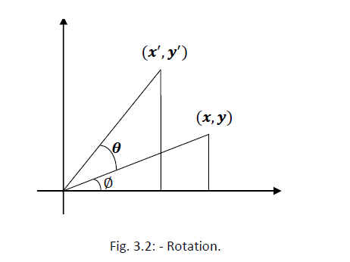

Slide 19
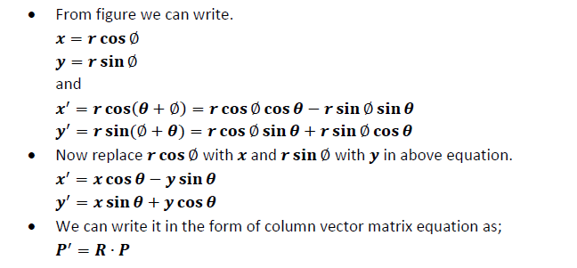

Slide 20
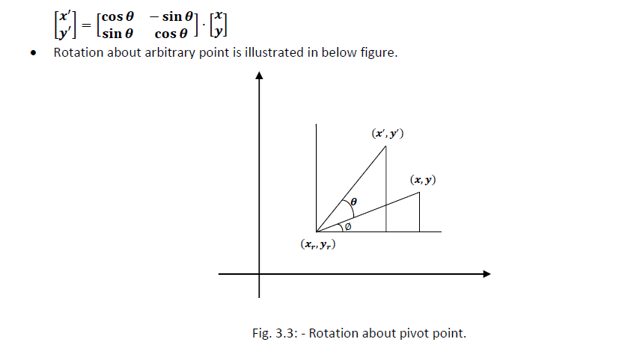

Slide 21
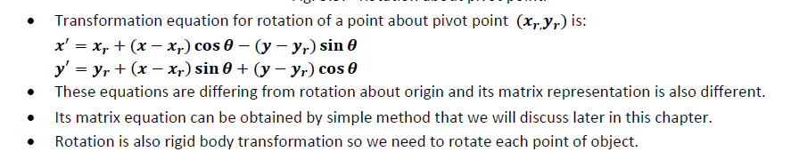

Slide 22
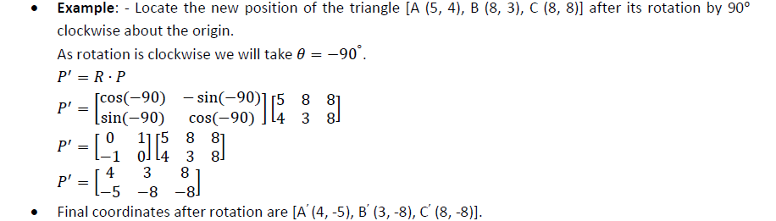

Slide 23
Functions of graphics.h
arc bar bar3d circle cleardevice closegraph drawpoly ellipse fillellipse fillpoly floodfill getarccords getbkcolor getcolor getdrivername getimage
getmaxcolor getmaxx getmaxy getpixel getx gety graphdefaults grapherrormsg imagesize line lineto linerel moveto moverel outtext outtextxy pieslice putimage putpixel rectangle
sector setbkcolor setcolor setfillstyle setlinestyle settextstyle setviewport textheight textwidth

Slide 25
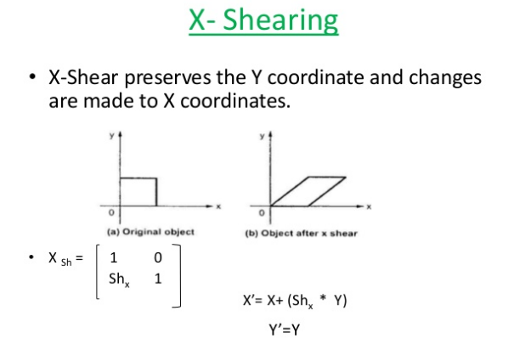

Slide 26
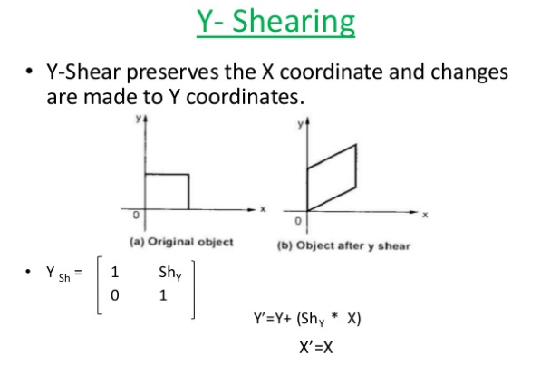

Slide 27
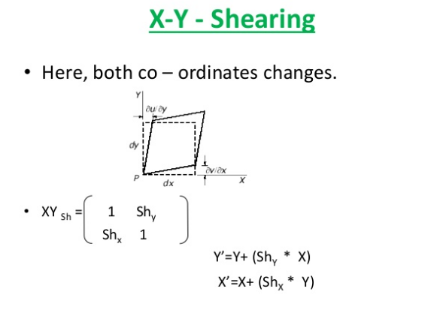

Slide 28
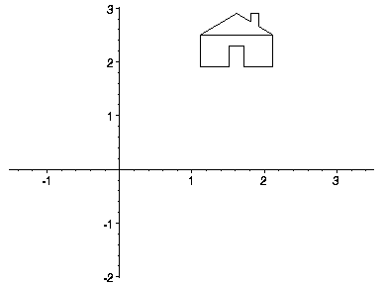
· Transformations are a fundamental part of the computer graphics. Transformations are the movement of the object in Cartesian plane .

Slide 29
There are two types of transformation in computer graphics.
1) 2D transformation
2) 3D transformation
Types of 2D and 3D transformation
1) Translation
2) Rotation
3) Scaling
4) Shearing
5) Mirror reflection

Slide 30

· Transformation are
used to
position
objects , to shape object , to change
viewing positions , and something is viewed.
even how
In simple words transformation is used for
1) Modeling
2) viewing

Slide 31
When the transformation takes place on a 2D plane .it is called 2D transformation.
2D means two dimensional (x-axis and Y-axis)
Object Transformation in 2D
Alter the coordinates descriptions an object
Translation , rotation , scaling , shearing,
reflection.
Coordinate system unchanged Coordinate transformation in 2D
Produce a different coordinate system

Slide 32
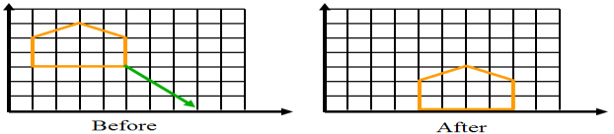
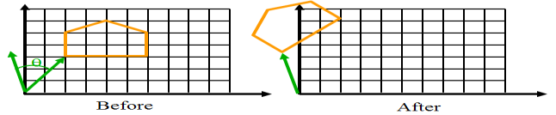
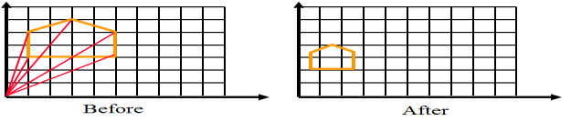
· Translation:-
Rotation:-
· Scaling:-

Slide 33
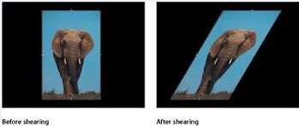
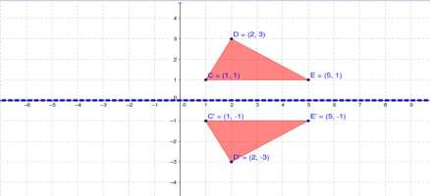
Shearing:-
Reflection

Slide 34


Slide 35

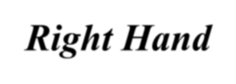
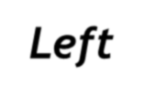



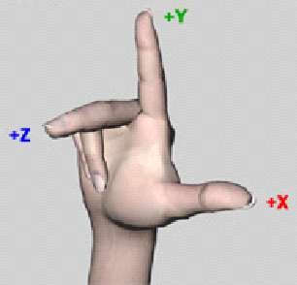
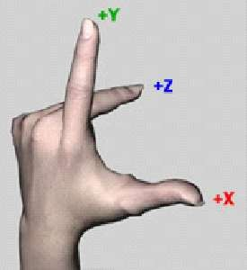
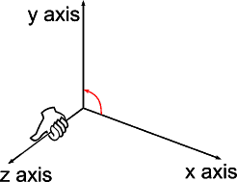
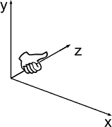
· Right Hand
coordinate system:
Left Hand
coordinate system

Slide 36
⎡ x⎤
Point We will consider points as column Vectors . Thus, a typical point with coordinates (x, y, z) is represented as:
⎢ _{y}⎥
⎢ ⎥
⎢⎣ z ⎥⎦
3D Point Homogenous Coordinate
A 3D point P is represented in homogeneous
coordinates by a 4-dim.
⎡ x ⎤
⎢ _{y}⎥
P = ⎢
⎥
The main advantage:- it is easier to compose translation and rotation
⎢ z ⎥
⎢₁ ⎥
⎣ ⎦

Slide 37
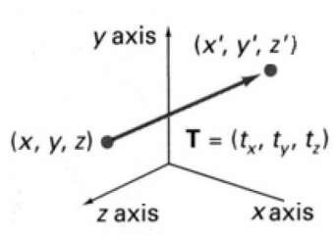


· Moving of object is called t r a n s l a t I o n
In 3 dimensional homogeneous coordinate representation , a point is transformed from position P = ( x, y , z) to P’=( x’, y’, z’)
This can be written as:- Using P’ = T . P
⎡ x′⎤
⎡1 0 0
1 0
0 1
0 0
t_{x} ⎤ ⎡ x⎤
⎢ _{y′}⎥ ⎢₀
_{t} ⎥ ⎢ _{y}⎥
⎢ ⎥ ₌ ⎢
^{y} ⎥ ⋅ ⎢ ⎥
⎢ z′⎥ ⎢0
t_{z} ⎥ ⎢ z ⎥
⎢ ₁ ⎥ ⎢₀
₁ ⎥ ⎢₁⎥
⎣ ⎦ ⎣
⎦ ⎣ ⎦

Slide 38
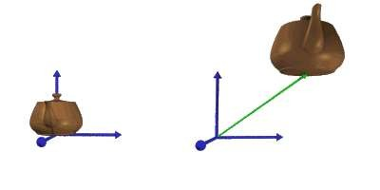
x’=x+ t_{x} , y’=y+ t_{y} , z’=z+ t_{z}
· The matrix representation is equivalent to the three equation.
Where parameter t_{x ,} t_{y ,} t_{z} are specifying translation distance for the coordinate direction x , y , z are assigned any real value.
Translate an object by translating each vertex in the object.

Slide 39



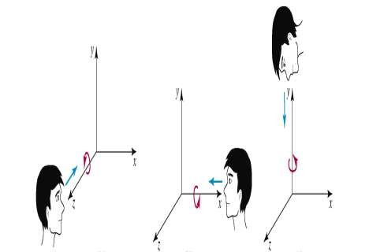
where an object is to be rotated about an axis that is parallel to one of the coordinate axis, we can obtain the desired rotation with the following transformation sequence.
Coordinate axis rotation
Z- axis Rotation(Roll) Y-axis Rotation(Yaw) X-axis Rotation(Pitch)

Slide 40


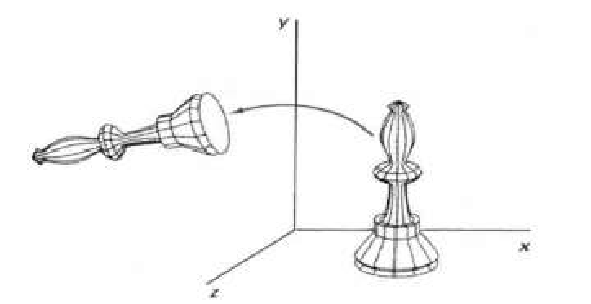
Z-axis rotation is same as the origin about in 2D for which we have the derived matrices already.
x’ = x cosθ – y sinθ y’ = x sinθ – y cosθ z’ = z
⎡ x'⎤ ⎡cosθ − sin θ 0
cosθ 0
0 1
0 0
0⎤ ⎡ x⎤
⎢ _{y'}⎥
⎢sin θ
₀⎥ ⎢ _{y}⎥
⎢ ⎥ ₌ ⎢
⎥ ⋅ ⎢ ⎥
⎢ z'⎥ ⎢
0
0
0⎥ ⎢ z ⎥
⎢ ₁ ⎥ ⎢
₁⎥ ⎢₁⎥
⎣ ⎦ ⎣
⎦ ⎣ ⎦

Slide 41
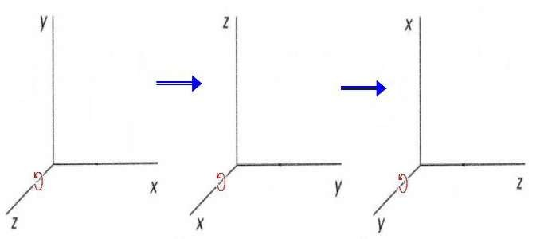
· Obtain rotations around other axes cyclic permutation of coordinate
paramet_{x}ers→:
y → z → x
·

Slide 42


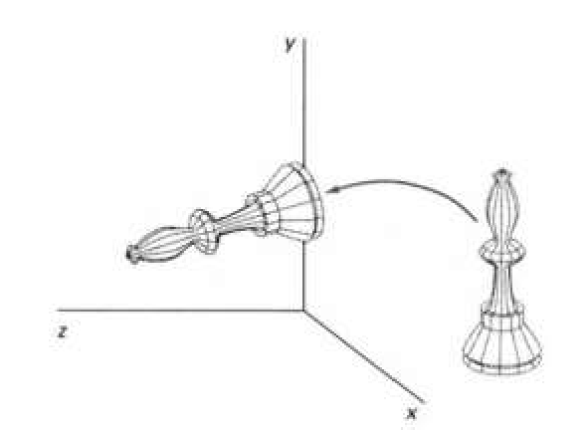
the equation for X-axis rotaion x’ = x
y’ = y cosθ – z sinθ z’ = y sinθ + z cosθ
⎡ x'⎤ ⎡1
0 0
cos θ − sin θ sin θ cos θ 0 0
0⎤ ⎡ x⎤
⎢ _{y'}⎥ ⎢₀
₀⎥ ⎢ _{y}⎥
⎢ ⎥ ₌ ⎢
⎥ ⋅ ⎢ ⎥
⎢ z'⎥ ⎢0
0⎥ ⎢ z ⎥
⎢ ₁ ⎥ ⎢₀
₁⎥ ⎢₁⎥
⎣ ⎦ ⎣
⎦ ⎣ ⎦

Slide 43


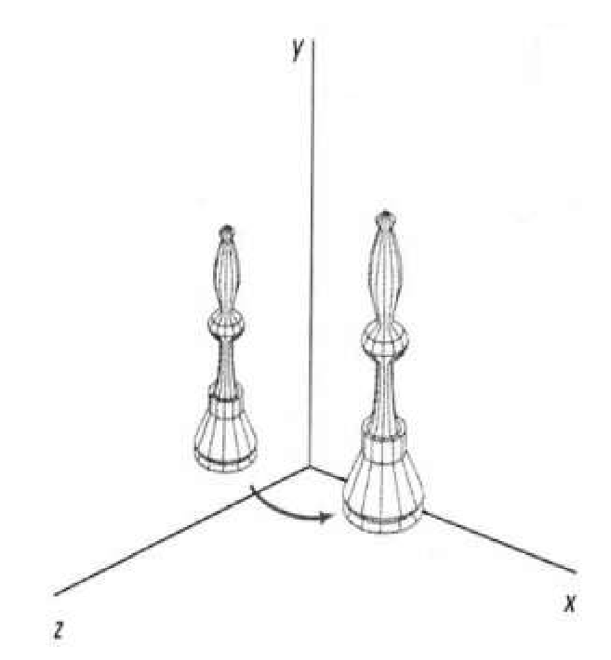
The equation for Y-axis rotaion x’ = x cosθ + z sinθ
y’ = y
z’ = z cosθ - x sinθ
⎡x'⎤ ⎡ cosθ 0 sin θ
1 0
0 cosθ 0 0
0⎤ ⎡x⎤
⎢ _{y'}⎥ ⎢
₀⎥ ⎢ _{y}⎥
0
⎢ ⎥ ₌ ⎢
⎥ ⋅ ⎢ ⎥
⎢ z'⎥ ⎢− sin θ
0⎥ ⎢ z ⎥
⎢ ₁ ⎥ ⎢
₁⎥ ⎢₁⎥
⎣ ⎦ ⎣
0
⎦ ⎣ ⎦

Slide 44


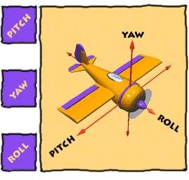
Pitch :- rotation Yaw:- rotation around the side to around the verti- side (about x-axis) cal axis(y-axis)
Roll:- Rotation around Front to back (Z-axis)

Slide 45

· Changes the size of the object and repositions
the object relative to the coordinate origin.
P ′ = S ⋅ P
⎡x′⎤
⎡s_{x} 0 0
s 0
0 s_{z}
0 0
0⎤ ⎡x⎤
⎢ _{y′}⎥ ⎢ ₀
₀⎥ ⎢ _{y}⎥
⎢ ⎥ ₌ ⎢
y
⎥ ⋅ ⎢ ⎥
⎢ z′⎥ ⎢ 0
0⎥ ⎢ z ⎥
⎢ ₁ ⎥ ⎢ ₀
₁⎥ ⎢₁⎥
⎣ ⎦ ⎣
⎦ ⎣ ⎦

Slide 46

· The equations for scaling
x’ = x . sx S_{sx,sy,sz} ➔ y’ = y . sy
z’ = z . sz
· The equations for scaling
x’ = x . sx
S_{sx,sy,sz} ➔ y’ = y . sy
z’ = z . sz

Slide 47


Reflection in computer graphics is used to emulate reflective objects like mirrors and shiny surfaces
Reflection may be an x-axis y-axis , z-axis. and also in
the planes xy-plane,yz-plane zx-plane.
Reflection relative to a given Axis are equivalent to 180 Degree rotations
, and

Slide 48


· Reflection about x-axis:-
· x’=x y’=-y z’=-z
· | 1 | 0 | 0 | 0
· | 0 | -1 | 0 | 0
· | 0 | 0 | -1 | 0
· | 0 | 0 | 0 | 1
Reflection about y-axis:- y’=y x’=-x z’=-z

Slide 49

· The matrix for reflection about y-axis:-
· | -1 | 0 | 0 | 0
· | 0 | 1 | 0 | 0
· | 0 | 0 | -1 | 0
· | 0 | 0 | 0 | 1
· Reflection about z-axis:-
· x’=-x | y’=-y | z’=z | -1 | 0 | 0 | 0
· |  |  | 0 | -1 | 0 | 0
· |  |  | 0 | 0 | 1 | 0
· |  |  | 0 | 0 | 0 | 1

Slide 50
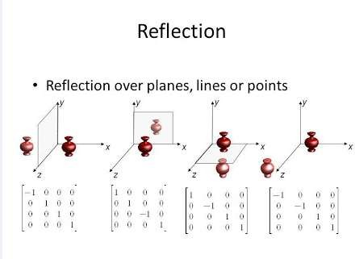

Slide 51

Modify object shapes
Useful for perspective projections
When an object is viewed from
different
directions and at different distances,
the
appearance of the object will be different. Such view is called perspective view. Perspective projections mimic what the human eyes see.
E.g. draw a cube (3D) on a screen (2D) Alter the values for x and y by an amount proportional to the distance from z_{ref}

Slide 53
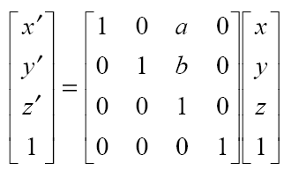
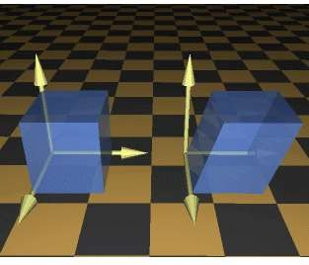
Matrix for 3d shearing
Where a and b can Be assigned any real Value.

Slide 54
3D translation Example
For Coordinates B(3, 3, 2)
Let the new coordinates of B = (Xnew, Ynew, Znew).
Applying the translation equations, we have-
Xnew = Xold + Tx = 3 + 1 = 4
Ynew = Yold + Ty = 3 + 1 = 4
Znew = Zold + Tz = 2 + 2 = 4
Thus, New coordinates of B = (4, 4, 4).
Given a 3D object with coordinate points A(0, 3, 1), B(3, 3, 2), C(3, 0, 0), D(0, 0, 0). Apply the translation with the distance 1 towards X axis, 1 towards Y axis and 2 towards Z axis and obtain the new coordinates of the object.
Given-
Old coordinates of the object = A (0, 3, 1), B(3, 3, 2), C(3, 0, 0), D(0, 0, 0)
Translation vector = (Tx, Ty, Tz) = (1, 1, 2)
For Coordinates A(0, 3, 1)
Let the new coordinates of A = (Xnew, Ynew, Znew).
Applying the translation equations, we have-
Xnew = Xold + Tx = 0 + 1 = 1
Ynew = Yold + Ty = 3 + 1 = 4
Znew = Zold + Tz = 1 + 2 = 3
Thus, New coordinates of A = (1, 4, 3).

Slide 55
For Coordinates D(0, 0, 0)
Let the new coordinates of D = (Xnew, Ynew, Znew).
Applying the translation equations, we have-
Xnew = Xold + Tx = 0 + 1 = 1
Ynew = Yold + Ty = 0 + 1 = 1
Znew = Zold + Tz = 0 + 2 = 2
Thus, New coordinates of D = (1, 1, 2).
Thus, New coordinates of the object = A (1, 4, 3), B(4, 4, 4), C(4, 1, 2), D(1, 1, 2).
For Coordinates C(3, 0, 0)
Let the new coordinates of C = (Xnew, Ynew, Znew).
Applying the translation equations, we have-
Xnew = Xold + Tx = 3 + 1 = 4
Ynew = Yold + Ty = 0 + 1 = 1
Znew = Zold + Tz = 0 + 2 = 2
Thus, New coordinates of C = (4, 1, 2).

Slide 56
3D rotation Example
For X-Axis Rotation-
Let the new coordinates after rotation = (Xnew, Ynew, Znew).
Applying the rotation equations, we have-
Xnew = Xold = 1
Ynew = Yold x cosθ – Zold x sinθ = 2 x cos90° – 3 x sin90° = 2 x 0 – 3 x 1 = -3
Znew = Yold x sinθ + Zold x cosθ = 2 x sin90° + 3 x cos90° = 2 x 1 + 3 x 0 = 2
Thus, New coordinates after rotation = (1, -3, 2).
Given a homogeneous point (1, 2, 3). Apply rotation 90 degree towards X, Y and Z axis and find out the new coordinate points.
Solution-
Given-
Old coordinates = (Xold, Yold, Zold) = (1, 2, 3)
Rotation angle = θ = 90º

Slide 57
For Y-Axis Rotation-
Let the new coordinates after rotation = (Xnew, Ynew, Znew).
Applying the rotation equations, we have-
Xnew = Zold x sinθ + Xold x cosθ = 3 x sin90° + 1 x cos90° = 3 x 1 + 1 x 0 = 3
Ynew = Yold = 2
Znew = Yold x cosθ – Xold x sinθ = 2 x cos90° – 1 x sin90° = 2 x 0 – 1 x 1 = -1
Thus, New coordinates after rotation = (3, 2, -1).
For Z-Axis Rotation-
Let the new coordinates after rotation = (Xnew, Ynew, Znew).
Applying the rotation equations, we have-
Xnew = Xold x cosθ – Yold x sinθ = 1 x cos90° – 2 x sin90° = 1 x 0 – 2 x 1 = -2
Ynew = Xold x sinθ + Yold x cosθ = 1 x sin90° + 2 x cos90° = 1 x 1 + 2 x 0 = 1
Znew = Zold = 3
Thus, New coordinates after rotation = (-2, 1, 3).

Slide 58
3D Scaling Example
For Coordinates A(0, 3, 3)
Let the new coordinates of A after scaling = (Xnew, Ynew, Znew).
Applying the scaling equations, we have-
Xnew = Xold x Sx = 0 x 2 = 0
Ynew = Yold x Sy = 3 x 3 = 9
Znew = Zold x Sz = 3 x 3 = 9
Thus, New coordinates of corner A after scaling = (0, 9, 9).
Given a 3D object with coordinate points A(0, 3, 3), B(3, 3, 6), C(3, 0, 1), D(0, 0, 0). Apply the scaling parameter 2 towards X axis, 3 towards Y axis and 3 towards Z axis and obtain the new coordinates of the object.
Solution-
Given-
Old coordinates of the object = A (0, 3, 3), B(3, 3, 6), C(3, 0, 1), D(0, 0, 0)
Scaling factor along X axis = 2
Scaling factor along Y axis = 3
Scaling factor along Z axis = 3

Slide 59
For Coordinates B(3, 3, 6)
Let the new coordinates of B after scaling = (Xnew, Ynew, Znew).
Applying the scaling equations, we have-
Xnew = Xold x Sx = 3 x 2 = 6
Ynew = Yold x Sy = 3 x 3 = 9
Znew = Zold x Sz = 6 x 3 = 18
Thus, New coordinates of corner B after scaling = (6, 9, 18).
For Coordinates D(0, 0, 0)
Let the new coordinates of D after scaling = (Xnew, Ynew, Znew).
Applying the scaling equations, we have-
Xnew = Xold x Sx = 0 x 2 = 0
Ynew = Yold x Sy = 0 x 3 = 0
Znew = Zold x Sz = 0 x 3 = 0
Thus, New coordinates of corner D after scaling = (0, 0, 0).
For Coordinates C(3, 0, 1)
Let the new coordinates of C after scaling = (Xnew, Ynew, Znew).
Applying the scaling equations, we have-
Xnew = Xold x Sx = 3 x 2 = 6
Ynew = Yold x Sy = 0 x 3 = 0
Znew = Zold x Sz = 1 x 3 = 3
Thus, New coordinates of corner C after scaling = (6, 0, 3).

Slide 60
3D Reflection Example
For Coordinates B(6, 4, 2)
Let the new coordinates of corner B after reflection = (Xnew, Ynew, Znew).
Applying the reflection equations, we have-
Xnew = Xold = 6
Ynew = Yold = 4
Znew = -Zold = -2
Thus, New coordinates of corner B after reflection = (6, 4, -2).
For Coordinates C(5, 6, 3)
Let the new coordinates of corner C after reflection = (Xnew, Ynew, Znew).
Applying the reflection equations, we have-
Xnew = Xold = 5
Ynew = Yold = 6
Znew = -Zold = -3
Thus, New coordinates of corner C after reflection = (5, 6, -3).
Thus, New coordinates of the triangle after reflection = A (3, 4, -1), B(6, 4, -2), C(5, 6, -3).
Given a 3D triangle with coordinate points A(3, 4, 1), B(6, 4, 2), C(5, 6, 3). Apply the reflection on the XY plane and find out the new coordinates of the object.
Solution-
Given-
Old corner coordinates of the triangle = A (3, 4, 1), B(6, 4, 2), C(5, 6, 3)
Reflection has to be taken on the XY plane
For Coordinates A(3, 4, 1)
Let the new coordinates of corner A after reflection = (Xnew, Ynew, Znew).
Applying the reflection equations, we have-
Xnew = Xold = 3
Ynew = Yold = 4
Znew = -Zold = -1
Thus, New coordinates of corner A after reflection = (3, 4, -1).

Slide 61
3D Shearing Example
For Coordinates B(1, 1, 2)
Let the new coordinates of corner B after shearing = (Xnew, Ynew, Znew).
Applying the shearing equations, we have-
Xnew = Xold = 1
Ynew = Yold + Shy x Xold = 1 + 2 x 1 = 3
Znew = Zold + Shz x Xold = 2 + 3 x 1 = 5
Thus, New coordinates of corner B after shearing = (1, 3, 5).
For Coordinates C(1, 1, 3)
Let the new coordinates of corner C after shearing = (Xnew, Ynew, Znew).
Applying the shearing equations, we have-
Xnew = Xold = 1
Ynew = Yold + Shy x Xold = 1 + 2 x 1 = 3
Znew = Zold + Shz x Xold = 3 + 3 x 1 = 6
Thus, New coordinates of corner C after shearing = (1, 3, 6).
Thus, New coordinates of the triangle after shearing in X axis = A (0, 0, 0), B(1, 3, 5), C(1, 3, 6).
Given a 3D triangle with points (0, 0, 0), (1, 1, 2) and (1, 1, 3). Apply shear parameter 2 on X axis, 2 on Y axis and 3 on Z axis and find out the new coordinates of the object.
Solution-
Given-
Old corner coordinates of the triangle = A (0, 0, 0), B(1, 1, 2), C(1, 1, 3)
Shearing parameter towards X direction (Shx) = 2
Shearing parameter towards Y direction (Shy) = 2
Shearing parameter towards Y direction (Shz) = 3
Shearing in X Axis-
For Coordinates A(0, 0, 0)
Let the new coordinates of corner A after shearing = (Xnew, Ynew, Znew).
Applying the shearing equations, we have-
Xnew = Xold = 0
Ynew = Yold + Shy x Xold = 0 + 2 x 0 = 0
Znew = Zold + Shz x Xold = 0 + 3 x 0 = 0
Thus, New coordinates of corner A after shearing = (0, 0, 0).

Slide 62
Shearing in Y Axis-
For Coordinates A(0, 0, 0)
Let the new coordinates of corner A after shearing = (Xnew, Ynew, Znew).
Applying the shearing equations, we have-
Xnew = Xold + Shx x Yold = 0 + 2 x 0 = 0
Ynew = Yold = 0
Znew = Zold + Shz x Yold = 0 + 3 x 0 = 0
Thus, New coordinates of corner A after shearing = (0, 0, 0).
For Coordinates B(1, 1, 2)
Let the new coordinates of corner B after shearing = (Xnew, Ynew, Znew).
Applying the shearing equations, we have-
Xnew = Xold + Shx x Yold = 1 + 2 x 1 = 3
Ynew = Yold = 1
Znew = Zold + Shz x Yold = 2 + 3 x 1 = 5
Thus, New coordinates of corner B after shearing = (3, 1, 5).
For Coordinates C(1, 1, 3)
Let the new coordinates of corner C after shearing = (Xnew, Ynew, Znew).
Applying the shearing equations, we have-
Xnew = Xold + Shx x Yold = 1 + 2 x 1 = 3
Ynew = Yold = 1
Znew = Zold + Shz x Yold = 3 + 3 x 1 = 6
Thus, New coordinates of corner C after shearing = (3, 1, 6).
Thus, New coordinates of the triangle after shearing in Y axis = A (0, 0, 0), B(3, 1, 5), C(3, 1, 6).

Slide 63
Shearing in Z Axis-
For Coordinates A(0, 0, 0)
Let the new coordinates of corner A after shearing = (Xnew, Ynew, Znew).
Applying the shearing equations, we have-
Xnew = Xold + Shx x Zold = 0 + 2 x 0 = 0
Ynew = Yold + Shy x Zold = 0 + 2 x 0 = 0
Znew = Zold = 0
Thus, New coordinates of corner A after shearing = (0, 0, 0).
For Coordinates B(1, 1, 2)
Let the new coordinates of corner B after shearing = (Xnew, Ynew, Znew).
Applying the shearing equations, we have-
Xnew = Xold + Shx x Zold = 1 + 2 x 2 = 5
Ynew = Yold + Shy x Zold = 1 + 2 x 2 = 5
Znew = Zold = 2
Thus, New coordinates of corner B after shearing = (5, 5, 2).
For Coordinates C(1, 1, 3)
Let the new coordinates of corner C after shearing = (Xnew, Ynew, Znew).
Applying the shearing equations, we have-
Xnew = Xold + Shx x Zold = 1 + 2 x 3 = 7
Ynew = Yold + Shy x Zold = 1 + 2 x 3 = 7
Znew = Zold = 3
Thus, New coordinates of corner C after shearing = (7, 7, 3).
Thus, New coordinates of the triangle after shearing in Z axis = A (0, 0, 0), B(5, 5, 2), C(7, 7, 3).

Slide 65
Contents
Polygon listing & filling criteria- ordered edge list representations
Polygon filling algorithms- Edge fill, fence fill, edge flag and seed fill algorithms

Slide 66
Polygon & Curve
A polygon is any 2-dimensional shape formed with straight lines. Triangles, quadrilaterals, pentagons, and hexagons are all examples of polygons. The name tells you how many sides the shape has. For example, a triangle has three sides, and a quadrilateral has four sides
A curve is a continuous and smooth flowing line without any sharp turns. One way to recognize a curve is that it bends and changes its direction at least once

Slide 67





Topic Covered
◆ Polygon
◆ Types
◆ Inside – Outside Test
◆ Polygon Filling
◆ Techniques
◆ Algorithms
◆ Example

Slide 68
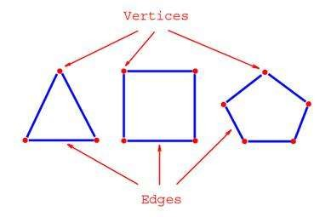
What is a Polygon….?
◆ A closed figure represented by a collection of more than 2 line segments connected end to end.
◆ The line segments are known as “Edge” of the Polygon and make up the Polygon boundary.
◆ Endpoints of the edges are known as “Vertex” of the Polygon.

Slide 69
Types Of Polygon
◆ Simple Convex
◆ Simple Concave
◆ Non-simple : self-intersecting
Convex
Concave
Self-intersecting

Slide 70




CONVEX
CONCAVE
All points on the line segment connecting two points of the Polygon are also inside the Polygon.
All points on the line segment connecting two points of the Polygon are not inside the Polygon.
All interior angles lesser than 180°.
At least one interior angle is greater than 180°.
< 180°
Convex
All of its lines curve outside
At least one line curve is inside.
One thing you may note about a convex shape is that, no matter where you draw a line that passes through the shape, it will always pass through only two of the lines or polygons making up the shape
If you try the same thing with a concave shape it can pass through more than two of the lines
> 180°
Concave

Slide 71
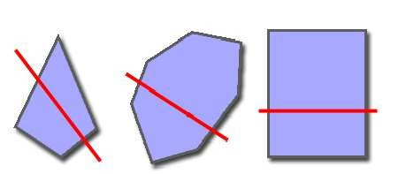
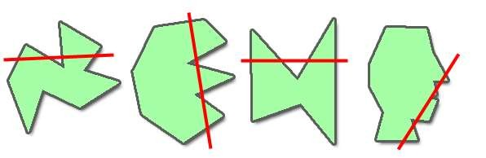
◆ CONVEX POLYGON:
◆ CONCAVE POLYGON:

Slide 72


Inside – Outside Test
◆ Even – Odd Test
◆ Winding Number Method
out
in
out
in

Slide 73



Even – Odd Test
◆ Also known as “Crossing Number Method”
◆ Construct a line segment which crosses the given Polygon and then count the number of time a line crosses the Polygon Boundary.
◆ If the crossing number is odd then the line is inside the Polygon, else
outside.
out
Special case : when point of intersection is the vertex .
in

Slide 74

Even – Odd Test: Special Case Handling
◆ Two cases:
◆ Case A: edges are monotonically increasing or decreasing
◆ Case B: edges reverse direction at endpoint
◆ In Case A, we should consider this as only ONE edge intersection.
◆ In Case B, we should consider this as TWO edge intersections.

Slide 75






Counts one
Case A
Counts two
Case B

Slide 76
Winding Number Method
◆ Instead of just counting the number of intersections, each edge crossed is given a direction number.
◆ Value of the direction number is :
◆
^{1, (Y}start ^{< Y}end⁾
◆ -1, (Y_{start} > Y_{end})
◆ Point is inside the Polygon if the sum of direction numbers is non-zero, else outside.

Slide 77





Example
1
-1
1
1+(-1)+1=1 , non-zero ,point inside

Slide 78
Polygon Filling
◆ Filling a Polygon is the process of coloring every pixel that comes inside the Polygon region.
◆ Techniques:
Boundary Fill Method
Flood Fill Method
Scan – Line Fill Method

Slide 79

Boundary Fill Method
◆ Also known as “Seed-Fill Method”
Draw Polygon boundaries
Fill up the seed point
A Seed-Point i.e. an arbitrary interior point is taken as the initial or the
starting point.
Test neighboring pixels
to determine whether they correspond to
the boundary pixel
If not, paint them with the fill-color and test their neighboring pixels
(store neighbors in stack)
Continue until all pixels have been tested

Slide 80
A considerable stack is used to store pixel information.
Basically, it is of two types :
4-Connected Seed Fill
8-Connected Seed Fill

Slide 81














4-Connected and 8-Connected Seed
(X, Y+1)
(X-1, Y+1)
(X, Y+1)
(X+1, Y+1)
(X-1, Y)
(X, Y)
(X+1, Y)
(X-1, Y)
(X, Y)
(X+1, Y)
(X, Y-1)
(X-1, Y-1)
(X, Y-1)
(X+1, Y- 1)

Slide 82

◆ The 4-connected pixel technique failed to fill the area as marked in the following figure which won’t happen with the 8-connected technique.

Slide 83

4 – Connected Example
Start Position

Slide 84

1
2
3

Slide 85

1 4
2

Slide 86

1
2

Slide 87

5 1

Slide 88

1

Slide 89


Slide 90
8 – Connected Example
Start Position

Slide 91


4 1 5
2 3

Slide 92


6
4 1
2
3

Slide 93


7 8
4 1
2
3

Slide 94


11 9 12
7 10
4 1
2
3

Slide 95


11 9
7
10
4 1
2
3

Slide 96


9
7
10
4 1
2
3

Slide 97


9
7
4 1
2
3

Slide 98


7
4 1
2
3

Slide 99


4 1
2
3

Slide 100


1
2
3

Slide 101


1
2

Slide 102


1

Slide 103



Slide 104
Algorithm: 4 Connected
◆ boundaryFill(int x, int y, int fill, int boundary) current = getPixel(x,y)
if(current < > boundary AND current < > fill) then setPixel(x,y,fill) boundaryFill(x+1,y,fill,boundary) boundaryFill(x-1,y,fill,boundary) boundaryFill(x,y+1,fill,boundary) boundaryFill(x,y-1,fill,boundary)
end if end

Slide 105
Flood Fill Method
◆ Modified form of Boundary Fill Method.
◆ Basic concept is just like Boundary Filling.
◆ Fill polygon starting with a “seed” point known to be inside the polygon & set the neighboring pixels until we encounter the boundary pixels.
◆ Polygon is filled just like pouring water in an empty bucket.
◆ Common example is the bucket-fill tool of MS-Paint.
◆ Like Boundary Fill Method, it is also used in games.

Slide 106
Algorithm:
void floodFill(int x, int y, int fillColor, int interiorColor) { int color;
getPixel(x,y,color)
if (color==interiorColor) {
setPixel(x,y,fillColor);
floodFill(x+1,y,fillColor,interiorColor); floodFill(x-1,y,fillColor,interiorColor); floodFill(x,y+1,fillColor,interiorColor); floodFill(x,y-1,fillColor,interiorColor);
}
}

Slide 107
Flood Fill Method: Working

Slide 108
Filling Irregular Boundaries
Boundary fill: expand and fill region until you reach boundary color
Fill
Boundary
◆ •Flood fill: expand and fill region while you find interior
color
Interior
Fill

Slide 109
◆ In brief:
Flood Fill and Boundary Fill are algorithms used with a chosen colour
for colouring a given figure
Flood Fill is one in which all connected pixels of a selected colour get
replaced by a fill colour.
Boundary Fill is very similar with the difference being the program stopping when a given colour boundary is found.

Slide 110
Scan - Line Fill Method
◆ Used in Raster Scan Devices.
◆ The scan-line algorithm works as follows:
Find intersections of the scan-line with all edges
Sort intersections in increasing x
Fill all the pixels between pairs of intersections
◆ Special Cases to handle:
Exclude horizontal edges
For vertices lying on scan-line
Count twice
i.

Slide 111
Scan - Line Example
10
9
8
7
6
5
4
3
2
1
0
0 1 2 3 4 5 6 7 8 9 10

Slide 112
Scan - Line Base Approach
10
Scan Line
8
6
4
2
0
2
4
6
8 10 12 14 16

Slide 113
































Scan - Line Draw Polygon
10
9
8
7
6
5
4
3
2
1
0
0 1 2 3 4 5 6 7 8 9 10

Slide 114








Scan - Line Filling Process
10
9
8
7
6
5
4
3
2
1
0
0 1 2 3 4 5 6 7 8 9 10

Slide 115








Scan - Line Filling Process
10
9
8
7
6
5
4
3
2
1
0
0 1 2 3 4 5 6 7 8 9 10

Slide 116








10
9
8
7
6
5
4
3
2
1
0
Filling Process
0 1 2 3 4 5 6 7 8 9 10

Slide 117






Scan - Line Filling Process
10
9
8
7
6
5
4
3
2
1
0
0 1 2 3 4 5 6 7 8 9 10

Slide 118








Scan - Line Filling Process
10
9
8
7
6
5
4
3
2
1
0
0 1 2 3 4 5 6 7 8 9 10

Slide 119







Scan - Line Filling Process
10
9
8
7
6
5
4
3
2
1
0
0 1 2 3 4 5 6 7 8 9 10

Slide 120






Scan - Line Filling Process
10
9
8
7
6
5
4
3
2
1
0
0 1 2 3 4 5 6 7 8 9 10

Slide 121






Scan - Line Filling Process
10
9
8
7
6
5
4
3
2
1
0
0 1 2 3 4 5 6 7 8 9 10

Slide 122


Example
◆ Initially, each vertices of the polygon is given in the form of (x,y) and is in an ordered array as such:
◆ Unfilled, the polygon would look like this to the human eye:

Slide 123
Steps
◆ 1.In order to fill a polygon, we do not want to have to determine the type of polygon that we are filling.
◆ 2. The basic concept of the scan-line algorithm is to draw points from edges of odd parity to even parity on each scan-line.
◆ 3.scan-line: A scan-line is a line of constant y value.

Slide 124

Algorithm
◆ 1.Initializing All of the Edges: all_edges table:
◆ The first thing that needs to be done is determine how the polygon's vertices are related. The all_edges table will hold this information.
The minimum y value of the two vertices.
The maximum y value of the two vertices.
The x value associated with the minimum y value
The slope of the edge.
◆ The formula for the slope is as follows:
◆ m = (y₀ - y₁) / (x₀ - x₁).
.

Slide 125
2. Global Edge Table: GET
◆ The global edge table will be used to keep track of the edges that are still needed to complete the polygon.
◆ Edges with the same minimum y values are sorted on minimum x values as
follows:
Place the first edge with a slope that is not equal to zero in the global edge table.
If the slope of the edge is zero, do not add that edge to the global edge table.

Slide 126


Slide 127
◆ 3.Initializing Parity
Parity is initially set to even. Yet now no edges has crossed.
◆ 4.Initializing the Scan-Line
we can safely choose lowest y value in the global edge table as our initial scan-line.
In our example it is 10.

Slide 128
5. Initializing the Active Edge Table
◆ The active edge table will be used to keep track of the edges that are intersected by the current scan-line. This should also contain ordered edges.
◆ This is initially set up as follows:
The global edge table is ordered on minimum y and x values, search through the global edge table and, for each edge found having a minimum y value equal to the current scan-line.
Append the edge information in the AET for the
Maximum y value
X value
1/m

Slide 129

3.Do this until an edge is found with a minimum y value greater than the scan line value.
◆ The active edge table will now contain ordered edges of those edges that are being filled as such:

Slide 130
Filling the Polygon
◆ Filling the polygon involves deciding whether or not to draw pixels, adding to and removing edges from the active edge table, and updating x values for the next scan-line.
◆ Starting with the initial scan-line, until the active edge table is empty, do the following:
Draw all pixels from the x value of odd to the x value of even parity edge pairs.
Increase the scan-line by 1.
Remove any edges from the active edge table for which the maximum y
value is equal to the scan_line.

Slide 131
Update the x value for each edge in the active edge table using the formula x₁ = x₀ + 1/m. (This is based on the line formula and the fact that the next scan-line equals the old scan-line plus one.)
Remove any edges from the global edge table for which the minimum y value is equal to the scan-line and place them in the active edge table.
Reorder the edges in the active edge table according to increasing x value. This is done in case edges have crossed.

Slide 132
Scan Line 10

Slide 133

◆ The polygon is now filled as follows:

Slide 134

Scan Line 11
Increase the scan-line by 1.
Update x₁ = x₀ + 1/m

Slide 135

◆ The polygon is now filled as follows:

Slide 136

◆ The polygon is now filled as follows:

Slide 137

Scan Line 15

Slide 138

◆ The polygon is now filled as follows:

Slide 139

Scan Line 16
Next scan Line value is 16.
This is equal to maximum value of y in AET. So we will remove these edges whose maximum y value is 16 from AET.

Slide 140

◆ We then need to update the x values for all remaining edges.

Slide 141


◆ Now we can add the last edge from the global edge table to the active edge table since its minimum y value is equal to the next scan-line. The active edge table now look as follows (the global edge table is now empty):

Slide 142


Slide 143


Slide 144

◆ Now that we have filled the polygon, let's see what it looks like to the naked eye:

Slide 145
Scan - Line Alogorithm
Set y to the smallest y coordinate that has an entry in the ET; i.e, y for the first nonempty bucket.
Initialize the AET to be empty.
Repeat until the AET and ET are empty:
◆ 3.1 Move from ET bucket y to the AET those edges whose y_min = y (entering edges).
◆ 3.2 Remove from the AET those entries for which y = y_max (edges not involved in the next scanline), the sort the AET on x (made easier because ET is presorted).
◆ 3.3 Fill in desired pixel values on scanline y by using pairs of x coordinates from AET.
◆ 3.4 Increment y by 1 (to the coordinate of the next scanline).
◆ 3.5 For each nonvertical edge remaining in the AET, update x for the new y.

Slide 146
Curve Representation & Visualization-
Non-parametric
parametric curves,
Interpolation,
Parabolic Blended curves,
Bezier curves
B-spline curves

